Slide 1



Insights to the Product Strategy Team in the Banking Domain
presentation by T.A Siva Bhavani

Slide 2
Data Collection Understanding problem statement Analyzed the data in which different tables | imported into power Bi Desktop Transformed & profiling is done Applied to power Bi Desktop | Data Modelling- relation between tables Measures -Dax | Data visualization is done and captured some useful insights. | Dashboard creating is done using power-BI services , and shared the live interactive dashboard to the PowerPoint | Final presentation to share the insights and recommendations
STEPS FOLLOWED TO PROVIDE THE INSIGHTS
6
5
4
3
2
1

Slide 3




Problem
Statement
Mitron Bank is a legacy financial institution headquartered in Hyderabad
. They want to introduce a new line of credit cards, aiming to broaden its product offerings and reach in the financial market.
AtliQ Data Services :- came to know about this through an internal link and approached Mitron Bank with a proposal to implement this project. However, strategy director of Mitron Bank, Mr.Bashnir Rover is skeptical and asked them to do a pilot project with the sample data before handing them the full project. They provided a sample dataset of 4000 customers across five cities on their online spend and other details.
Peter Pandey is a data analyst at AtliQ Data Services and asked by his manager to take over this project. His role is to analyze the provided sample data and report key findings to the strategy team of Mitron Bank.
Put your thoughts here.
Put your thoughts here.
Put your thoughts here.

Slide 4
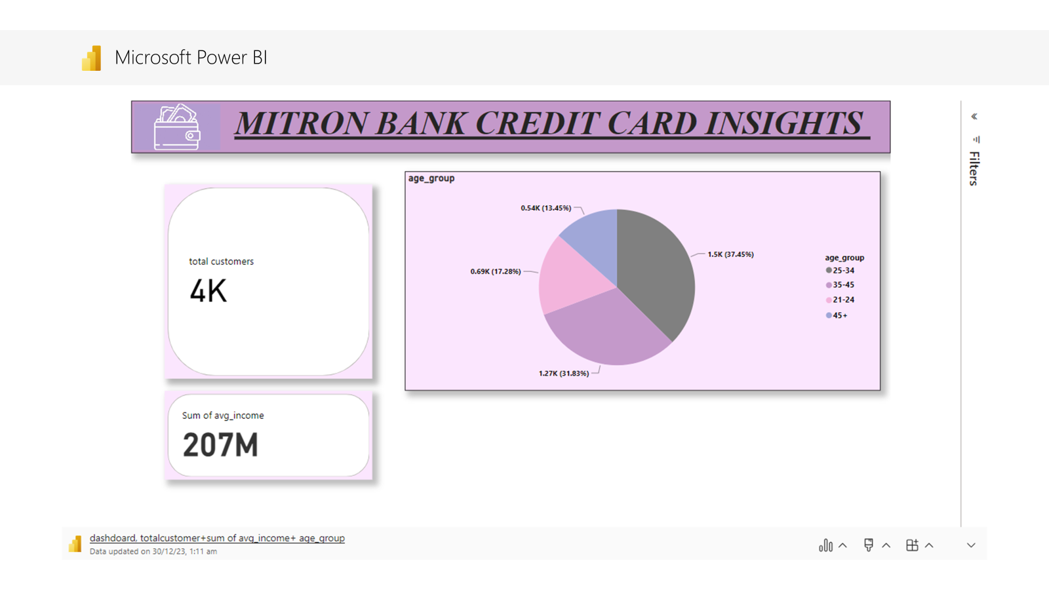
Insight
There are 4k customers ,whose Average income of them is 207M by each month, from those 4k customers I have noticed that the age group of around (25-35)&)(35-45) are more in number .

Slide 5
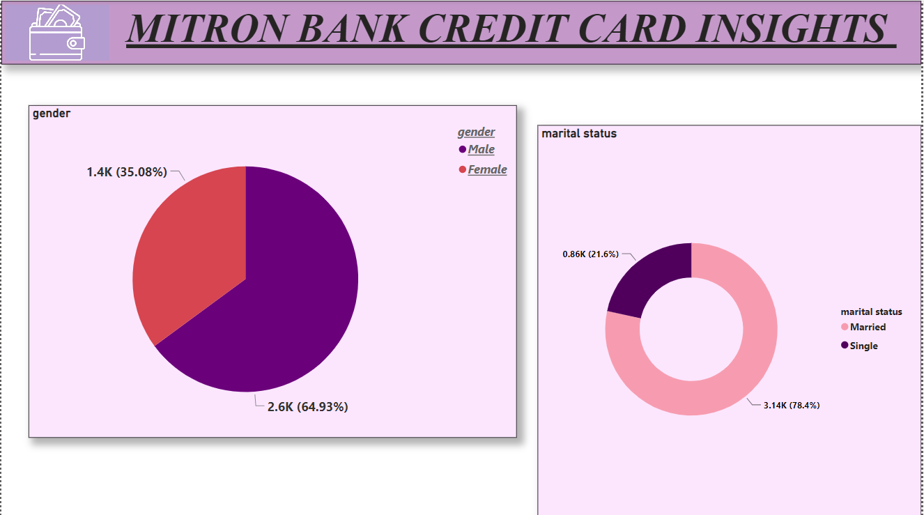
Insight
Among all those 4k customers the male% >female%,Male-2.6k( 64.93%), Females-1.4(35.08%), comingg to the marital status married customers are more than compared to single customers

Slide 6
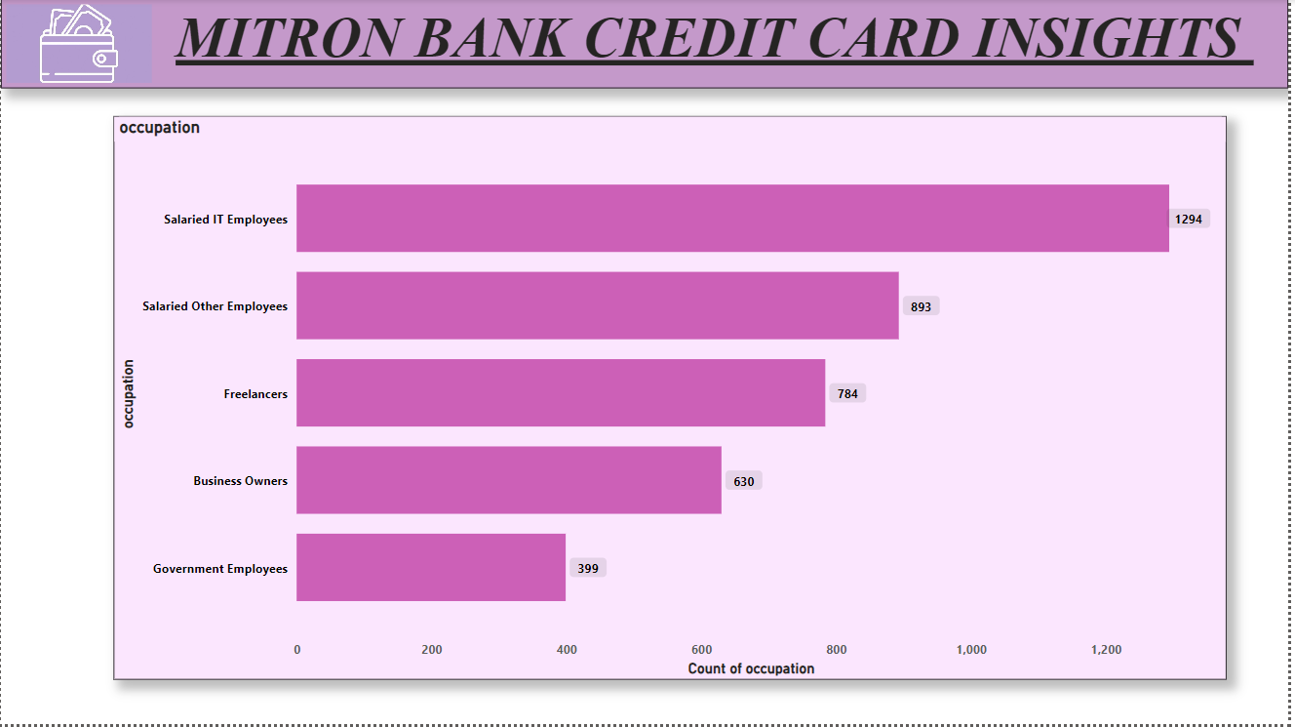
Insight
From the 4k customers all are from different background in point occupations .
There are people from Freelancers, Business Owners, Government Employees, Salaried IT-employees, Salaried Other Employees.
Among them Salaried IT-employees noticeably more when compared to others ( 1294 k)

Slide 7
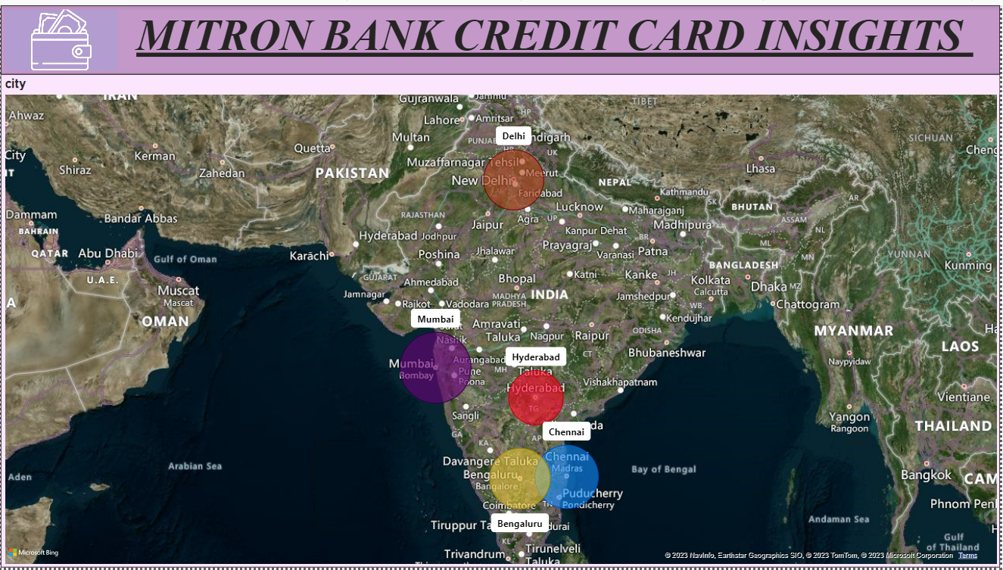
Insight
We have customers from differnt Cities such as Hyderabad , Bengaluru , Mumba i , Chennai, Delhi
And the count of customers are more in Mumbai ,Chennai , Bengaluru , when compared to other cities(where you can observe that with the size of the bubble)

Slide 8
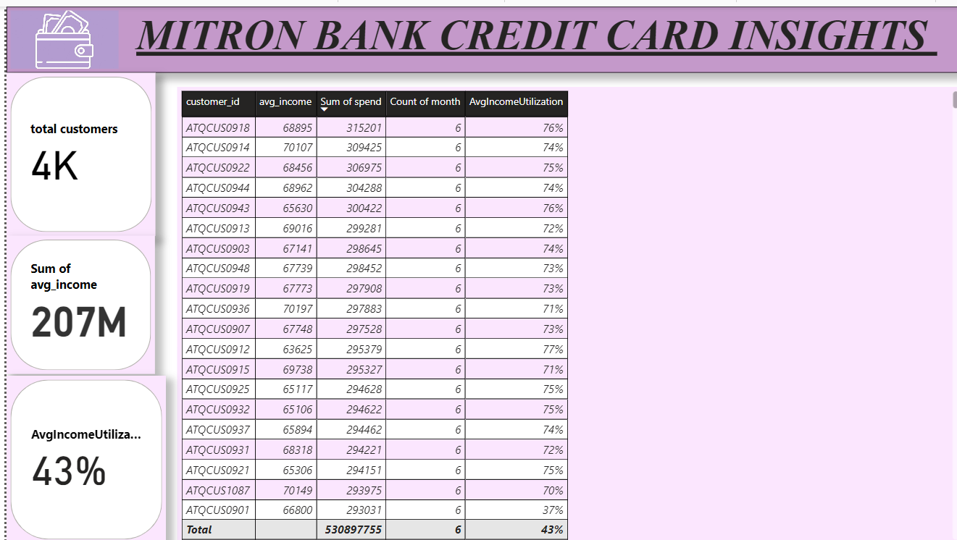
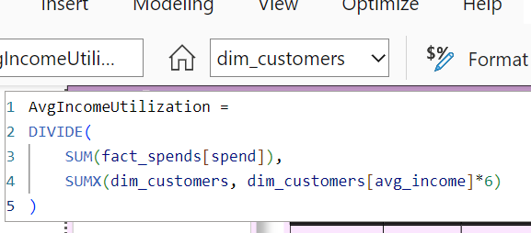
M,MBB N
Insight
Here from the metrix it is observed that avg -income for each month , but the sum of spent was for 6 months given and I calculated the avg_income utilization using measures .
it is observed thst 43% is the avgerage income utilization for overall 6 months.

Slide 9
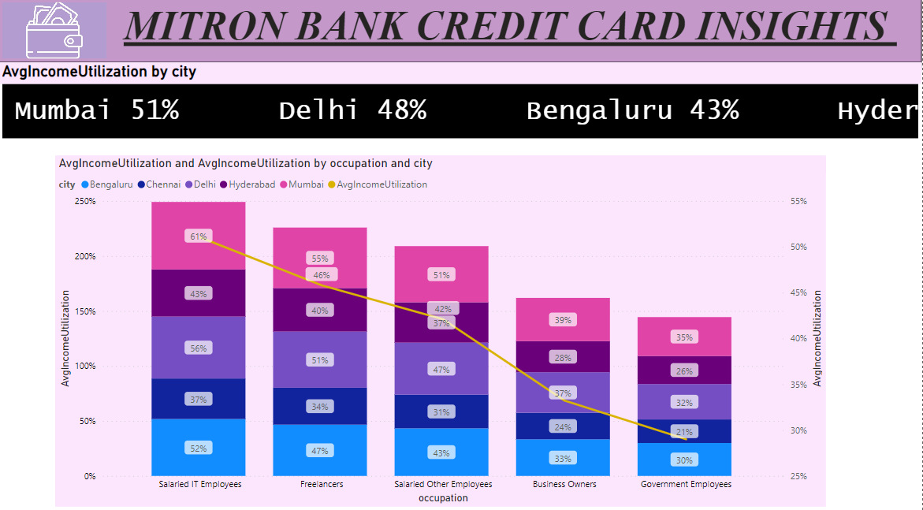
Insight
The average income utilization by city is represented by using line & stacked column chart.
It is observed that the income utilized is more by the salaried IT employees .
That too they are utilizing 61% of there income in Mumbai, 56% in Delhi, 52% in Bengaluru .
Next to the salaried IT employees , Freelancers are the customers who are utilizing more.

Slide 10
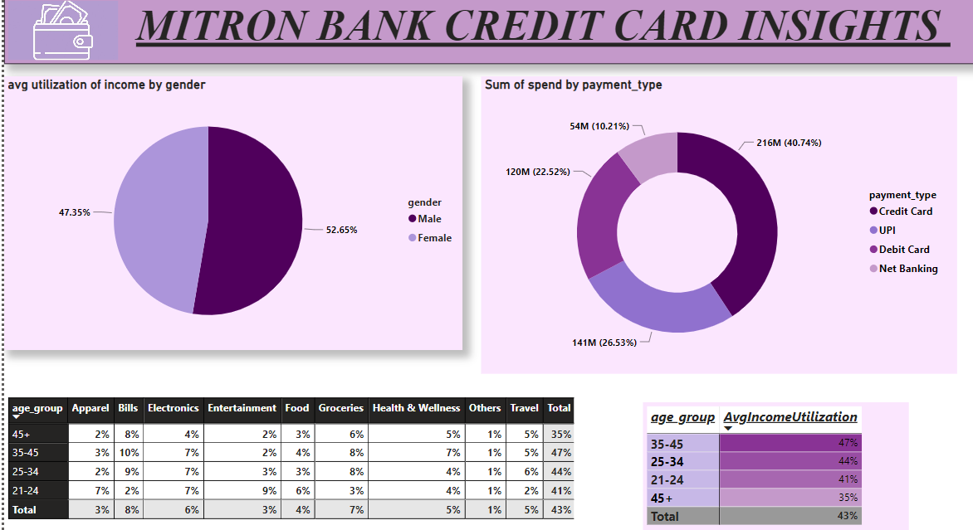
Insight
Male (52.65%)are utilizing the average income more >females(47.35%), furthermore filtering down using interactive filters it is observed that male customers not only utilizing but also spending more by using the credit-card payment type after UPI.
And age group of below 45 yrs (mostly by 25-45 yrs )are spending more on different things like Apparels , Bills , Electronics , Food , Groceries, Health & wellness ,Travels.
It is observed that mostly spending is done on “Bills”, ”Groceries” ,”Electronics”.

Slide 11


RECOMMENDATIONS BASED ON MY ANALYSIS
After Analysing the demographical data according to my analysis ,Target product launch can be to the customers below the age of 45 years . Mostly to the Young Professionals , especially those Who are starting their career and for the customers in their middle of25- 45 years as they often use credit cards for convenience, building credit history, and accessing perks like rewards and cashback. And also to the male customers as they are mostly spending there average income . Target product launch can also to the Individuals with middle - high average income customers such as salaried it employees etc , as per my analysis , as it is observed that credit card and UPI is noticeably used more by this customers . Target product launch can be in city’s like “Mumbai” , “Delhi” , “ Bengaluru” , and also to some extent in Hyderabad. As it is observed that the age group of of below 45 yrs (mostly by 25-45 yrs )are spending more on “Bills”, ”Groceries” ,”Electronics” so Introducing or enhance rewards programs to offer cashback, discounts, or points for specific spending categories or frequent usage might be the great idea .

Slide 12

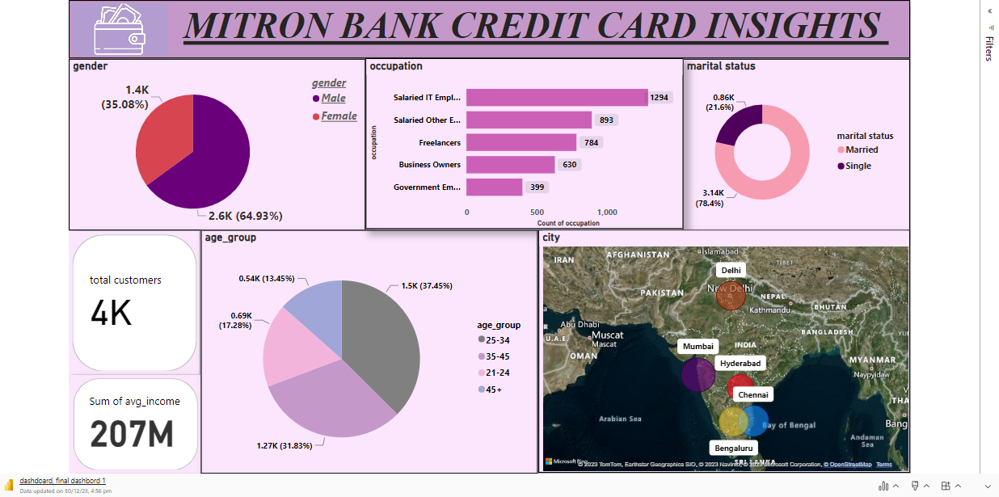
Microsoft Power BI

Slide 13
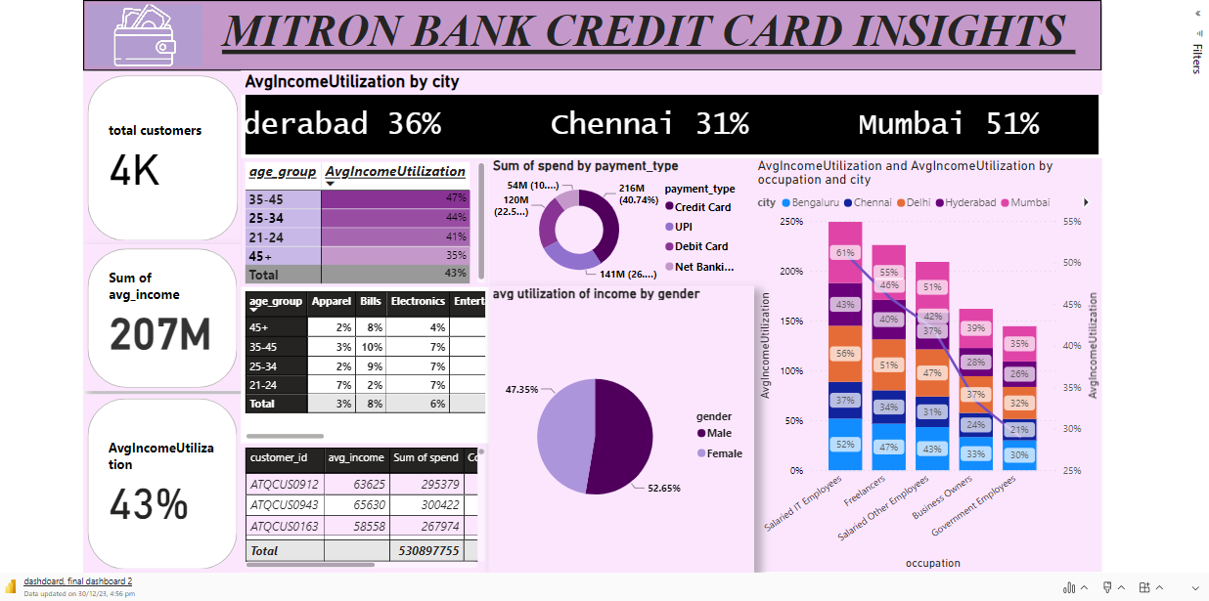
Microsoft Power BI

Slide 14




